Slide 1
Sales Data Analysis
By Opara Franklin E.
TOOLS USED: Excel & Power BI
August, 2025

Slide 2
INTRODUCTION
This Restaurant Dataset; Sales data analysis takes a dive into looking at sales records of restaurant in different regions to gain insight and analyze monthly sales record for proper evaluation and project customer behavioral pattern in the month of Nov – Dec 2024.
OBEJECTIVES
Evaluate growth, product mix, and channel mix
Identify trends
Recommend actionable next steps for profitable sales

Slide 3
DATA OVERVIEW
DATA SOURCE
Kaggle (Sales transactions dataset )
SIZE OF DATASET
This data has 254 rows and 11 columns
KEY VARIABLES
Revenue, product, Order.
ANY DATA CLEANING DONE
Cleaning and removing of duplicated values.

Slide 4
METHODOLOGY
Excel and Power Bi was used during the cause of analyzing this project topic.
Excel was used in cleaning text field (Trim/Clean)
Power Bi was used to transform my data and also create calculated field (Revenue, AOV, Order)
Sourced my data from Kaggle, imported my dataset into Excel for cleaning, then transform my data in Power Bi for analyzing and visualization.

Slide 5
(KPIS)
KEY METRICS / KPIS CALCULATED
Total Revenue,
Order
Avg Order Value
Total Quality

Slide 6
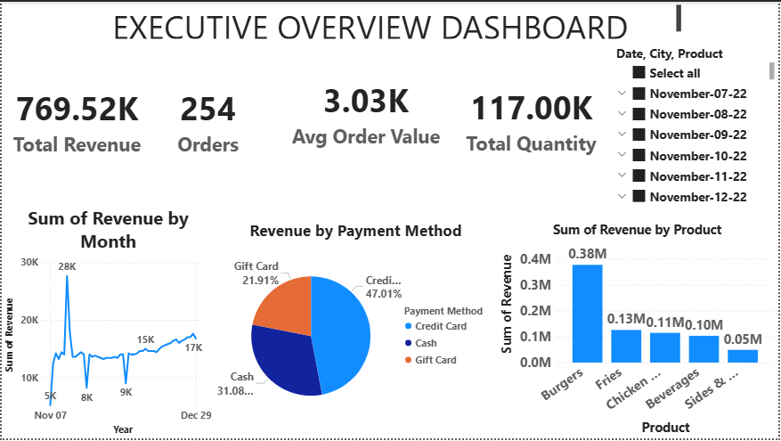
VISUALS

Slide 7
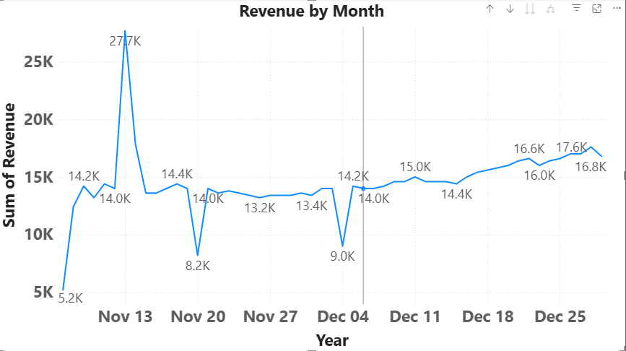
Revenue Over Time
Revenue refers to the income generated in business operation primarily from sales to customers.
Highlight peak and trough period in revenue.

Slide 8
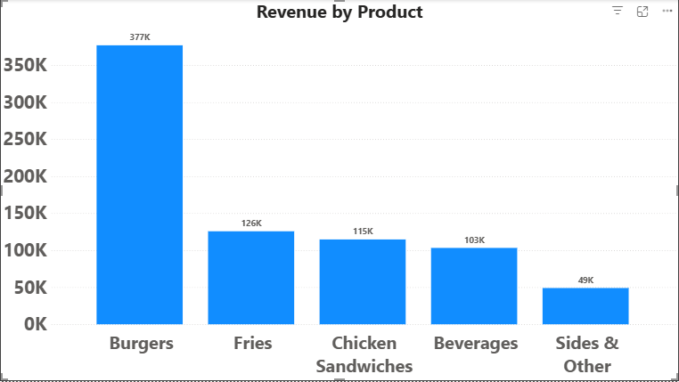

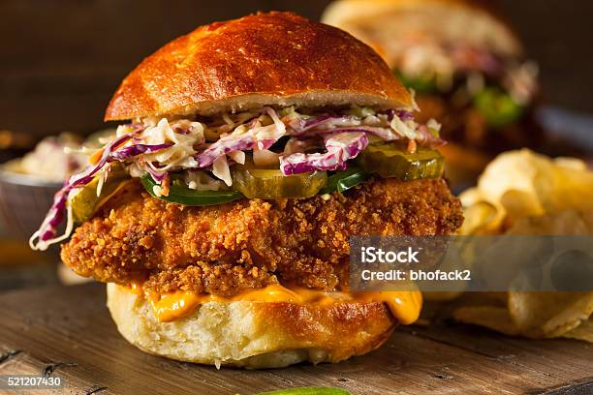
Product Mix
Revenue by product
Highest selling product (revenue)
Lowest selling product (revenue)
Burger vs Chicken sandwiches
Dominant product

Slide 9
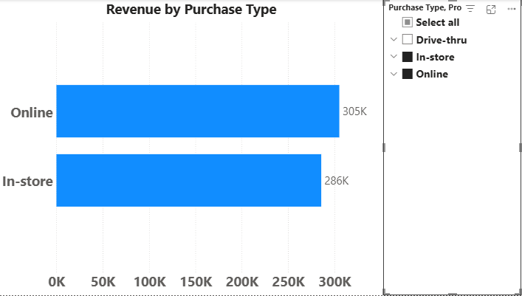
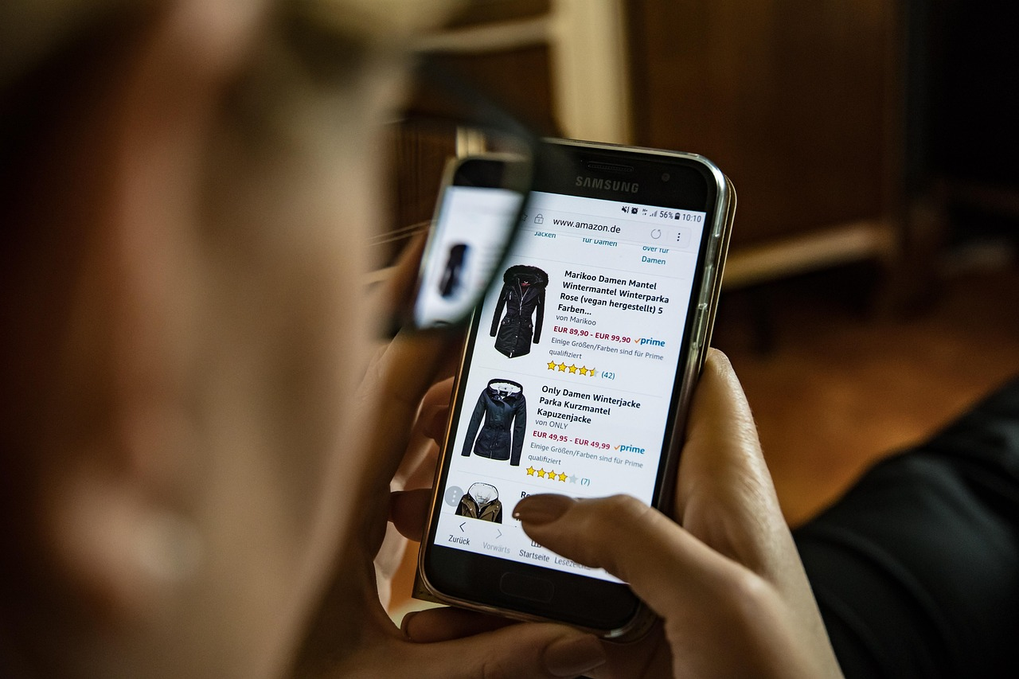

Channel Mix
Revenue generated between Nov - Dec
Online & In-store purchases
Identify shift or seasonal changes such as convenience and price.

Slide 10
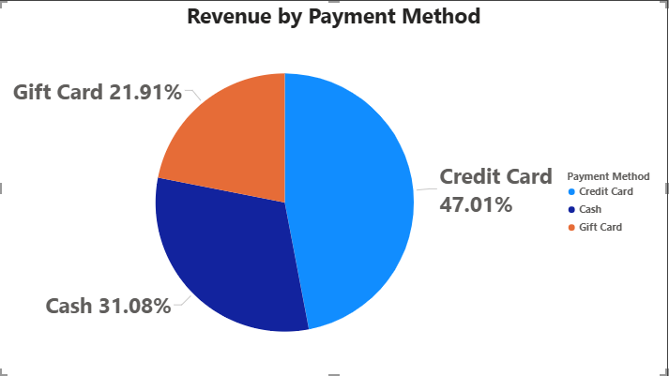



Payment Behavior
Breakdown by payment method refers to a detailed report that quantifies different payment used by customers.
Key payment method used.
Trends on payment method over time simply put the total monetary value of transactions for each payment and customers preference.

Slide 11
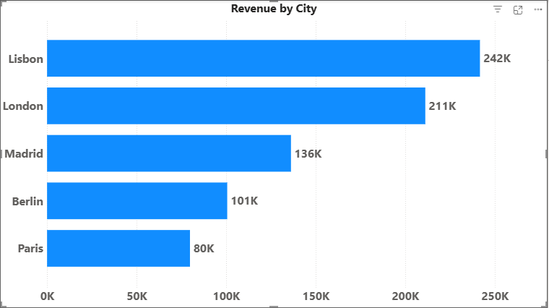

Geography
Revenue by City for Nov-Dec 2024
Highlight top/bottom performers

Slide 12
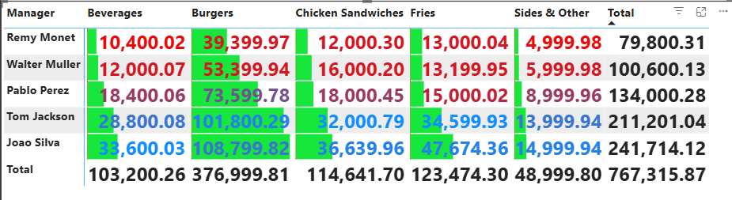
Manager View
Highlight performance gaps between Nov-dec
By product.
By Managers and revenue
Importance of this analysis

Slide 13
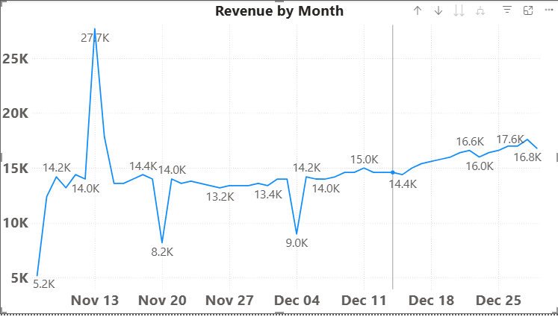
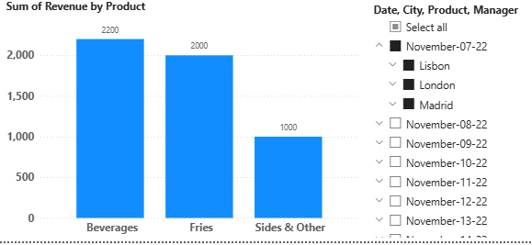
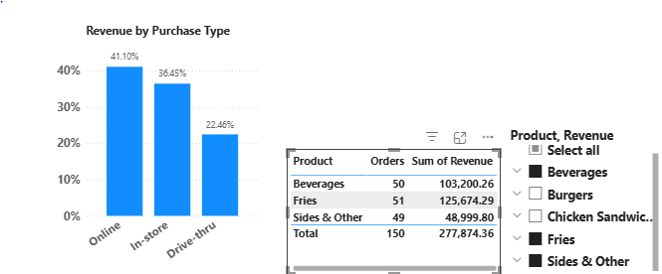
Insights

Slide 14
Recommendations
Pricing and promotion strategies;
Channel optimization
Manager coaching opportunities

Slide 15
Conclusion
From the just concluded analysis done on the sales dataset between Nov- Dec 2024 we can see the trend of customer purchase from the peak period to the trough period also how different cities influences the sales of certain products and customers preferred payment method.

Slide 16
References
I will like to mention Kaggle from where I got my dataset from (Sales data analysis).
And a very big thank you to my tutor miss Dishaa for your support and walking me through during my journey as a data analyst.
My colleagues riding with you all has been an amazing journey, we hope for the best which is yet to come…
………. GRACIAS

